Slide 1
OPEN THE BOX
Please View This Op-Ed in “Presentation Mode” for the Full Experience.

Slide 2
What
words
come to mind
when you
see
this image
?

Slide 3
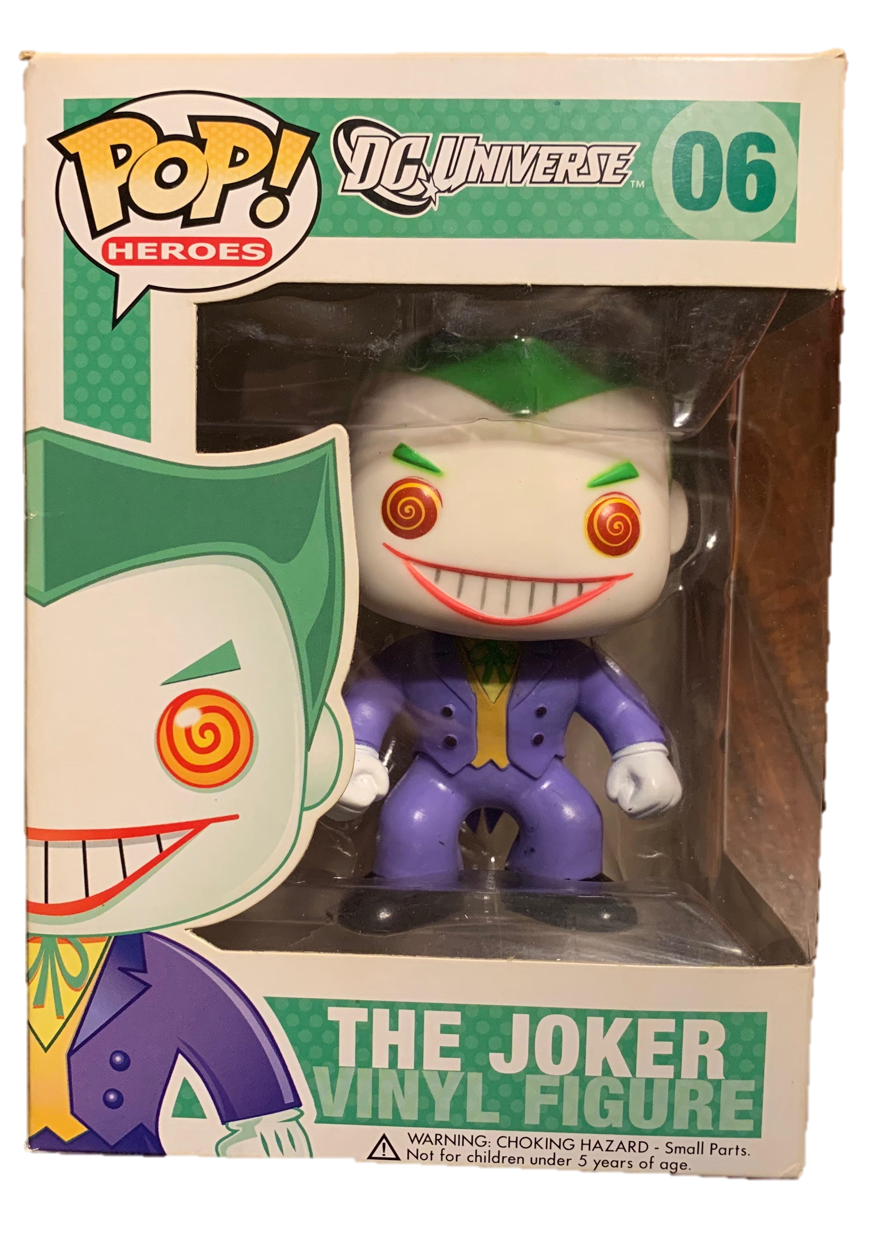
I’m sure that these words
flashed through your mind at least once.
Doll
Funko
Joker
Green
White
Purple
Orange
Figure

Slide 4
Keep those words in mind while I tell you a story.

Slide 5
Write them down if you have to.

Slide 6
I’ll wait.

Slide 7
Not because I have to.

Slide 8
Just because I’m a nice person.

Slide 9
Let me set the scene for you.

Slide 10
You’re thirteen years old.

Slide 11
You’ve been crushing on
“that person”
all school year.

Slide 12
You know
that person
“that person”,
the one that
everyone
wants to date,
but no one has the
nerve
to ask out.

Slide 13
Well, it seems that luck is on your side for once.

Slide 14
Despite all the people who “that person” could have picked,

Slide 15
“That person” decided
to ask you out!

Slide 16
The two of you become the talk of the school.

Slide 17
Only a bit of time passes
before even the teachers
begin to joke that the two of you will get married.

Slide 18
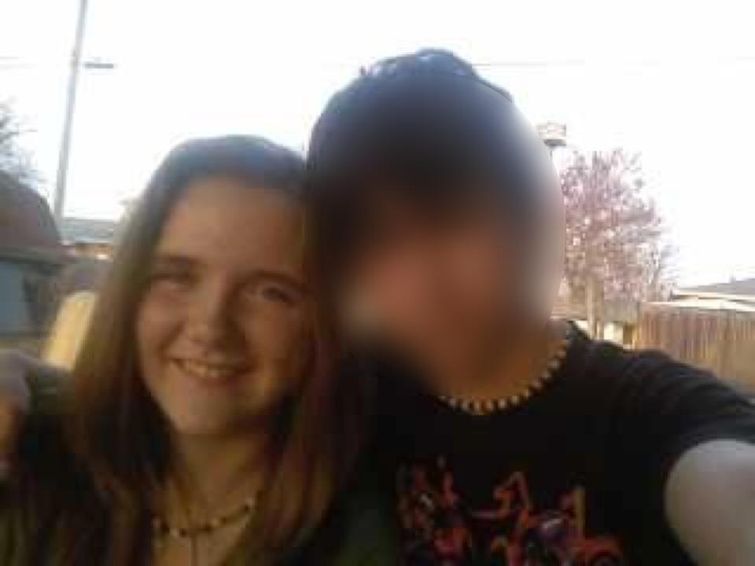
You have cookouts
at each
other’s houses.

Slide 19
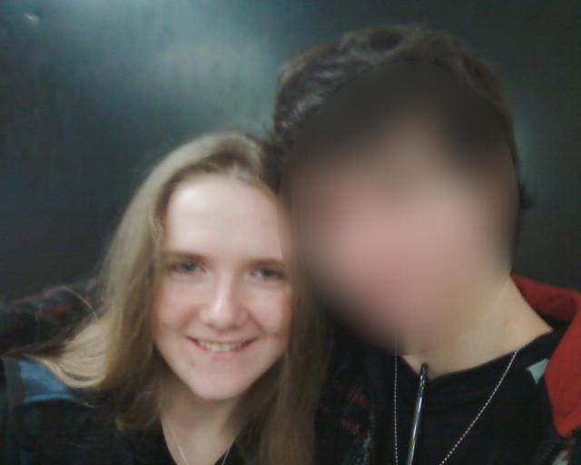
You constantly have people asking to take your photo in the school hallways.

Slide 20
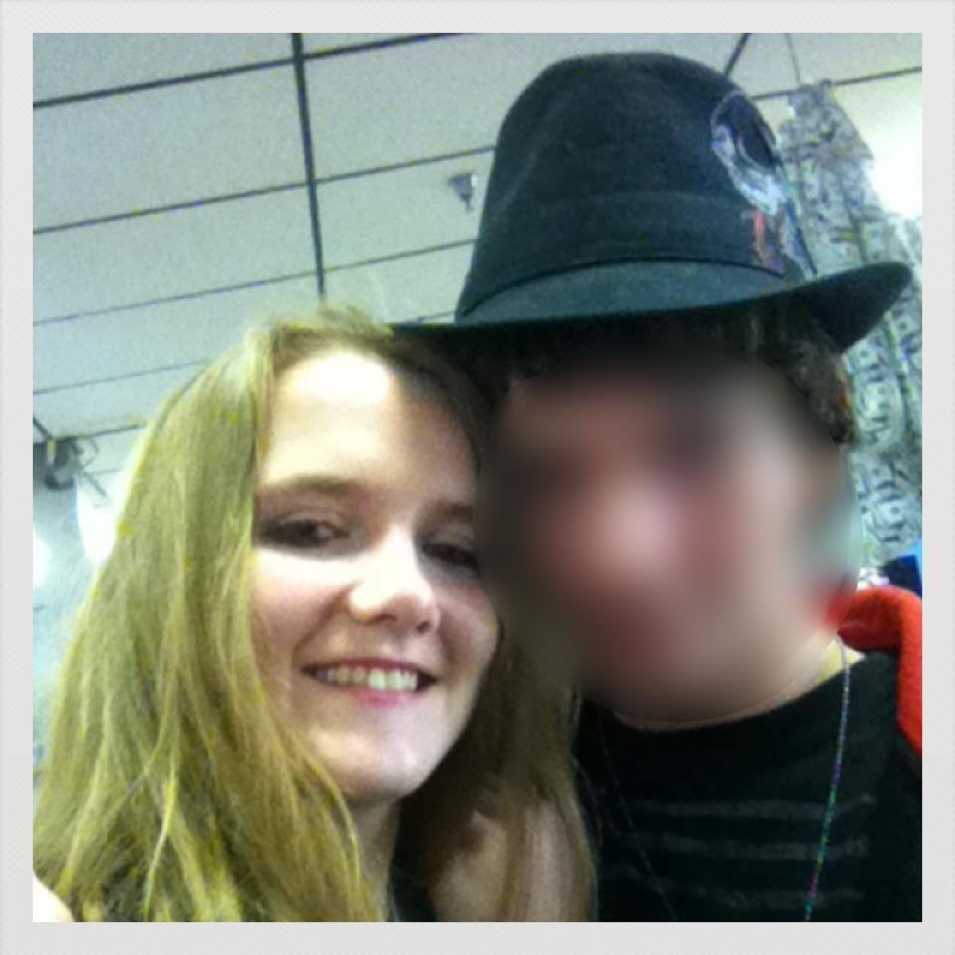
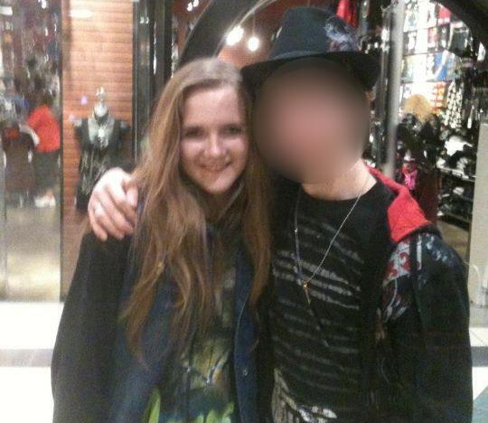
You turn every trip to the mall into a mini-photoshoot.

Slide 21
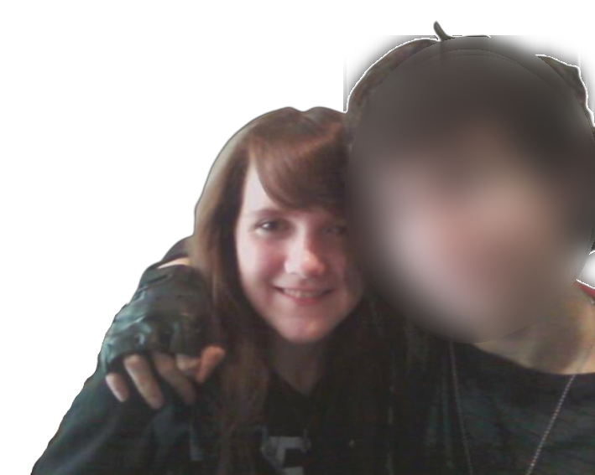
You dye your hair because he thinks that you’ll
look “better” as
a brunette.

Slide 22
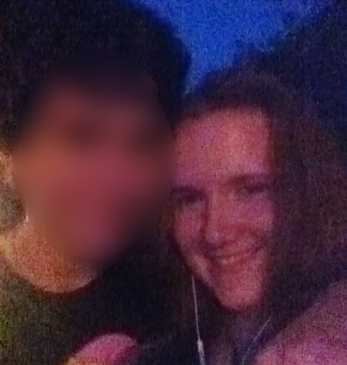
You learn to take less photos
OR
to take them in darker lighting.

Slide 23
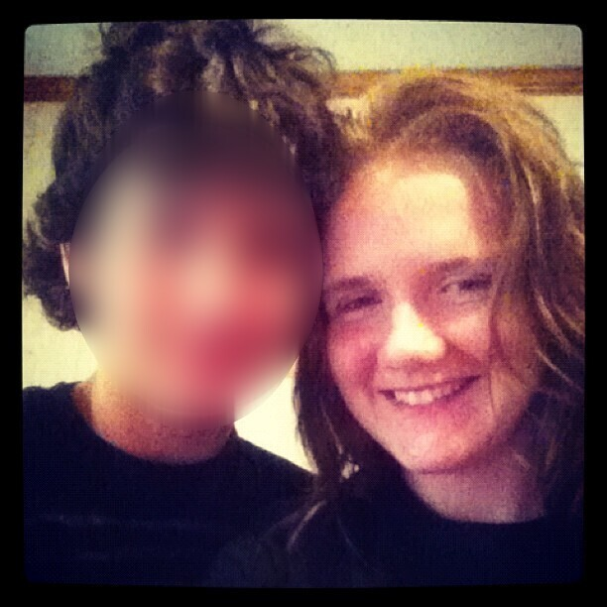
You learn to
act
like things are
fine.

Slide 24
You don’t know when you learned to carry a compact of make-up everywhere with you.

Slide 25
You just remember what it felt like to have his fingernails leave a
burning trail across your neck.

Slide 26
You don’t remember when you stopped hanging out with all of your friends.

Slide 27
You just recall that time when he said that he loved “to make you look like [his] bitch in front of
your friends.”

Slide 28
Even though you don’t remember a lot of the specifics,

Slide 29
You do remember the moment that you became aware of what was happening.

Slide 30
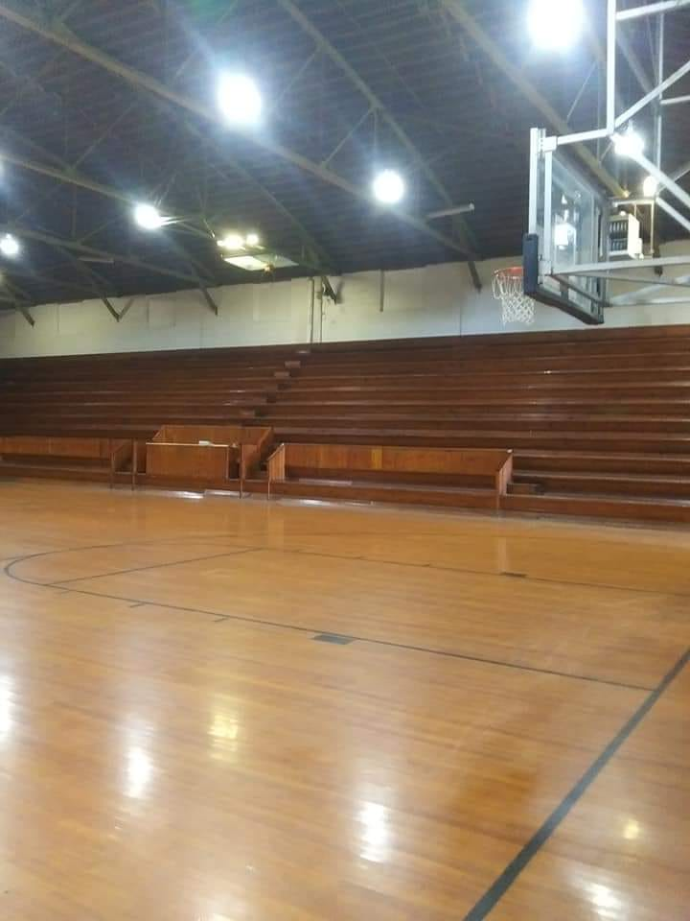
You were sitting
here
with him.
Your forgotten friends were sitting
here.

Slide 31
You had just finished doing some practice free-throw shots as mandated by your basketball coach.

Slide 32

He was watching you with pride as you gloated about your *shot percentage being higher than usual.
*Shot percentage = $\frac{Number of shots made}{Number of total shots}$ x 100

Slide 33
and failing
You made a joke
– trying
to flirt –
about how your percentage would have been higher had he not been there to distract you.

Slide 34
Things are about to get bad for you.

Slide 35
Are you sure you want to continue?

Slide 36
Apparently you do.

Slide 37
You’re a little naïve,

Slide 38
But I’ll continue the story
anyways.

Slide 39
The word “distraction” lingers in the air for a moment.

Slide 40
The arm that was casually slung around your shoulders…

Slide 41
Slowly
vice
around
neck.
into
turns
your
a

Slide 42
As you are struggling for breath,

Slide 43
Two things happen at the same time.

Slide 44
1) He growls into your ear that he is not a distraction.

Slide 45
2) You see out of the corner of your eye that your friends are staring.

Slide 46
You try to ask your friends for help with your eyes.

Slide 47
You hope against all hope that one of them will get the message.

Slide 48
One of them does.

Slide 49
She goes to get the teacher.

Slide 50
You can taste salvation on your tongue even as it becomes impossible to breathe.

Slide 51
The teacher comes out and spots the two of you.

Slide 52
“Just a reminder everyone!
PDA is not allowed!”

Slide 53
You still can’t breathe even though his arm is long gone.

Slide 54
That fleeting feeling of salvation stays with you for weeks…

Slide 55
Until you finally decide to break up with him.

Slide 56
You send him a text simply stating,
“I can’t do this anymore.”

Slide 57
He doesn’t fight with you because he knows that what he has done is wrong.

Slide 58
He even tells you as much when he sends back a text that is filled with apologies.

Slide 59
But the story gets twisted after a while…

Slide 60
Into one where you turn out to be a liar…

Slide 61
And he the victim.

Slide 62
Now, I’m curious.

Slide 63
How long do you think it would take you to heal after something like this?

Slide 64
I didn’t start to heal until I was suddenly hit by a series of epiphanies.

Slide 65
I was driving home from college.

Slide 66
A playlist from an artist called Halsey was blaring through my car’s speakers…

Slide 67
When I heard lyrics from two songs that took me back to when I was that thirteen-year-old girl who was dating “that person.”

Slide 68
“Well, King Midas put his hands
on me again…
but I don’t let him
touch me anymore.”

Slide 69
“I bet you kiss your knuckles
Right before they touch my cheek…”

Slide 70
As I repeatedly listened to these two songs, the first epiphany came to me…

Slide 71
I
wasn’t
alone.

Slide 72
Knowing that someone like Halsey had gone through the same thing lifted a weight off my shoulders that I didn’t even know I was carrying.

Slide 73
That is until I got home and spotted a gift that he had given me sitting on my shelf…

Slide 74
The
green,
white,
purple,
and orange
Funko
Joker
figure…

Slide 75
Suffering
Pain
Choke
Heartbreak
Sadness
Suffocating
ABUSE
And these words came to my mind.
Bitch
Depression
Loneliness
Scratch
Blame
Worthlessness
Lost
Hurt

Slide 76
I had a second epiphany in that moment.

Slide 77
That little doll represented
him.

Slide 78
I had placed him
and all of the memories
and all of the emotions
into an imaginary box.

Slide 79
So,
I
opened
the
box…

Slide 80
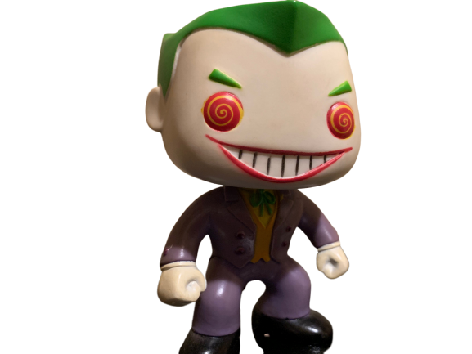
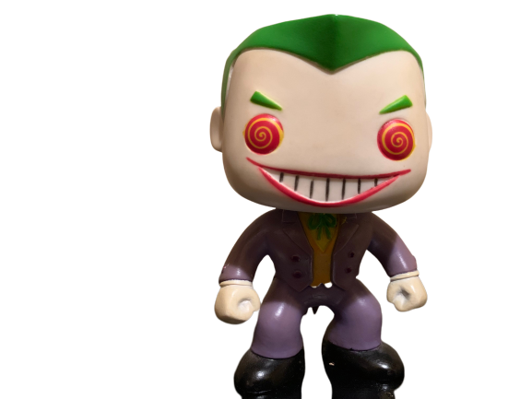
By
writing
this essay.

Slide 81
As a musician, Halsey placed her story within her song lyrics.
As a writer, I placed my story within an essay.

Slide 82
I told you
my story
not
because I
want to hear another
“I’m sorry.”

Slide 83
I told you my story to help myself.

Slide 84
Maybe Halsey was trying to do the same thing.

Slide 85
But maybe that’s just wishful thinking.

Slide 86
Maybe I’ll never truly
open the box.

Slide 87
Maybe it can’t be opened.

Slide 88
Maybe that little box is the only thing that is protecting me.

Slide 89
Maybe that box will always be
a part of me.

Slide 90
But maybe that’s the secret.

Slide 91
That box will always be a
part
of me
but not
all
of me.

Slide 92
In fact,

Slide 93
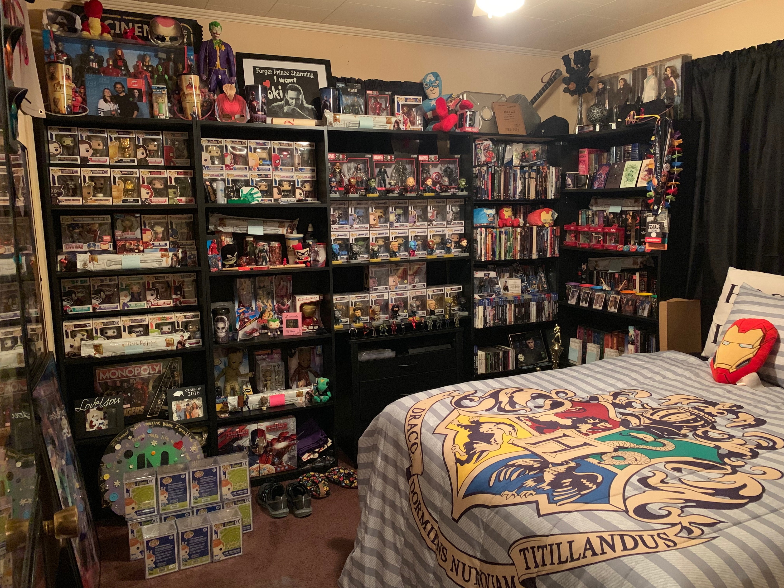
You can also see my love of
Harry Potter.
The posters that I don’t
have room for.
This is a photo of my room.
All of the convention badges that I have collected.
You can see the Joker figure
here.
The time I met Tom Hiddleston.
And
so
much
more.

Slide 94
So, you can see
that
little
doll
is just
a small piece of
me.

Slide 95
I opened my box for me.

Slide 96
Now, it’s time to open your box.

Slide 97
Are you a musician like Halsey?
Are you a writer like me?
Or are you something completely different?

Slide 98
How will you tell your story?
In a song?
In an essay?
In a poem?
In a painting?
In a film?
In a speech?
In a dance?
In a play?

Slide 99
Who will you tell it to?
The world?
Your teacher?
Your classmates?
Your family?
Your friends?
Yourself?

Slide 100
None of that matters.

Slide 101
All that matters is…

Slide 102
Your willingness to accept that
you do have a box…

Slide 103
And you have the power to
rip open that box…

Slide 104
And
tell
your
story.

Slide 105
Open the Box
A Visual Op-Ed by Nikki Gordon
Lyrics Used
All song lyrics were created, recorded, and published by Halsey and company.
“100 Letters” can be found here:
https://www.youtube.com/watch?v=bP4Yr8bGuDQ
and “Trouble” can be found here:
https://www.youtube.com/watch?v=h2aTxmwRiJQ
Photos Used
All were taken by Nikki Gordon
except the photo of the
Leachville Junior High Gym
which was found here:
https://www.facebook.com/Leachville-Gym-Project-2202233439827975/

